Slide 1

Exceptions
Session 12

Slide 2
Review
The layout manager class provides a means for controlling the physical layout of GUI elements.
The different types of layouts are as follows:
  FlowLayout
  BoxLayout
  BorderLayout
  CardLayout
  GridLayout
  GridBagLayout
A layout can be changed with the setLayout()method
The FlowLayout is the default Layout Manager for applets and panels.

Slide 3
Review Contd…
The BoxLayout is a full featured version of FlowLayout.
The BorderLayout arranges components in the ‘North’, ‘South’, ‘East’, ‘West’, and ‘Center’ of a container.
The GridLayout places components in rows and columns. All components are of the same size.
The CardLayout places components on top of each other. It creates a stack of several components, usually panels.
The GridBagLayout places components more precisely than any other layout manager. The only difference is that the components need not be of the same size and can be placed in any row or column.
SpringLayout Manager was incorporated in Java 1.4 and defines relationship between the edges of components.

Slide 4
Objectives
Define an exception
Explain exception handling
Describe the try, catch, and finally blocks
Examine multiple catch blocks
Explore nested try / catch blocks
Explain the use of throw and throws keywords
Create user defined exceptions
Learn usage of Assert statement

Slide 5



What is an exception?
If an error is encountered while executing a program, an exception occurs.
ERROR !!
example :
4 / 0 =
When an exception occurs program terminates abruptly and control returns to operating system.
Exception handling is performed to identify errors and trap them.

Slide 6
Handling exceptions – General example
Snippet of a pseudocode follows:
  …………
  IF B IS ZERO GO TO ERROR
  C = A/B
  PRINT C
  GO TO EXIT
  ERROR:
  DISPLAY “DIVISION BY ZERO”
  EXIT:
  END
Block that
handles error

Slide 7
Handling exceptions in Java
Error handling in Java is performed with the help of an exception-handling model.
Occurrence of an error causes an exception to be thrown, which is caught in a block.
Error and Exception classes handle errors in Java.
When an exception occurs, an instance representing that exception is created. The instance is then passed to the method that retrieves and processes the information.
Error class exceptions are internal errors
  e.g. – reading a file from a floppy without inserting it in the floppy drive

Slide 8
Handling exceptions in Java Contd…
Java exception handling is managed through five keywords: try, catch, throw, throws, and finally.
Program statements, that have to be monitored for exceptions, are contained within a try block.
By using catch keyword, the programmer can catch the exception and handle it in some rational manner.
To manually throw an exception, we use the keyword throw.
Throws clause is used in a method to specify that this method will throw out an exception.
In the finally block, we can specify the code that is absolutely necessary to be executed before a method returns.

Slide 9
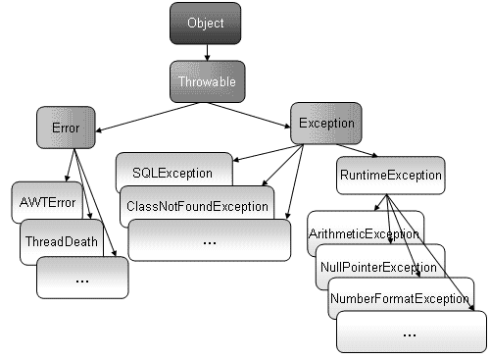
Hierarchy of Exception Classes

Slide 10
Exception handling model
Handled by five keywords – try, catch, throw, throws, and finally
Two ways to handle exceptions in Java:
  Statements that may throw exceptions are in the try block and exception handling statements in the catch block
  A method may be declared in such a way that in case an exception occurs, its execution is abandoned

Slide 11
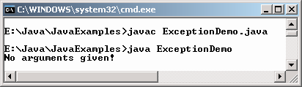
try and catch block - Example
class ExceptionDemo
{
public static void main(String args[])
{
try
{
String text = args[0];
System.out.println(text);
}
catch(Exception ne)
{
System.out.println("No arguments given! ");
}
}
}
Output

Slide 12
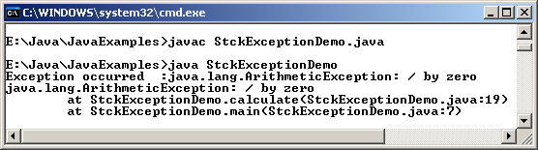
A sample program to demonstrate exceptions
public class StckExceptionDemo
{
public static void main(String args[])
{
try
{
int num = calculate(9,0); // user defined method
System.out.println(num);
}
catch(Exception e) // exception object
{
System.err.println("Exception occurred :" + e.toString());
e.printStackTrace();
}
}
static int calculate( int no, int no1)
{
int num = no / no1;
return num;
}
}
Output

Slide 13
Methods used in the example
toString() retrieves a String representation of the information stored in an Exception object
printStackTrace() is used to print out the cause of exception and also the line in the code which generated it

Slide 14
finally block
Ensures that all cleanup work is taken care of when an exception occurs
Used in conjunction with a try block
Guaranteed to run whether or not an exception occurs
An exception if thrown will run the finally block even if there is no matching catch block
No exception
finally
try block
catch block
finally
Exception

Slide 15
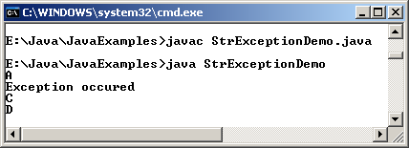
finally block - Example
class StrExceptionDemo
{
static String str;
public static void main(String s[])
{
try
{
System.out.println("A");
StrExceptionDemo.staticLengthmethod();
System.out.println("B"); //this code is not executed
}
catch(NullPointerException ne)
{
System.out.println("Exception occured");
System.out.println("C");
}
finally
{
System.out.println("D");
}
}
static void staticLengthmethod()
{
System.out.println(str.length());
}
}
Output

Slide 16
Multiple catch blocks
Single piece of code can generate more than one error.
Hence, multiple catch blocks may have to be provided.
Each catch statement has an order of appearance.
……….
    try{
    }
    catch(ArrayIndexOutOfBoundsException e) {
    }
    catch(Exception e) {
    }
    ……….
ArrayIndexOutOfBoundsException being a subclass of Exception class is handled first.

Slide 17
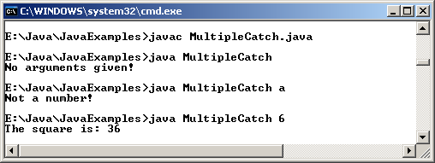
Example
class MultipleCatch
{
public static void main(String args[])
{
try
{
String num = args[0];
int numValue = Integer.parseInt(num);
System.out.println("The square is: " + numValue * numValue);
}
catch(ArrayIndexOutOfBoundsException ne)
{
System.out.println("No arguments given!");
}
catch(NumberFormatException nb)
{
System.out.println("Not a number!");
}
}
}
Output

Slide 18
Nested try - catch blocks
At times, a part of one block may cause an error and the entire block may cause another error.
In such a case, exception handlers have to be nested.
When nested try blocks are used, inner try block is executed first.
If no matching catch block is encountered, catch blocks of outer try blocks are inspected until all nested try statements are executed.

Slide 19
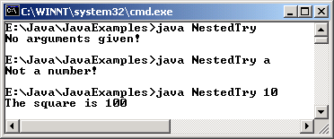
Example
class NestedTry
{
public static void main(String args[])
{
try
{
int num = args.length;
try
{
int numValue = Integer.parseInt( args[0]);
System.out.println("The square is " + numValue * numValue);
}
catch(NumberFormatException nb)
{
System.out.println("Not a number! ");
}
}
catch(ArrayIndexOutOfBoundsException ne)
{
System.out.println("No arguments given! ");
}
}
}
Output

Slide 20
Using throw & throws
Exceptions are thrown using throw keyword.
  try
  {
  if(flag<0)
  {
  throw new NullPointerException();
  }
  }
A single method may throw more than one exception.

Slide 21
Using throws
public class Example
{
public void exceptionExample()
{
try
{
// statements
check();
}
catch(Exception e)
{
//statements
}
}
// multiple exceptions separated by a comma
void check() throws NullPointerException, NegativeArraySizeException
{
if (flag < 0)
throw new NullPointerException();
if(arrsize < 0)
throw new NegativeArraySizeException();
}
}
check() method includes the throws keyword
Such methods should be invoked within a try / catch blocks

Slide 22
User defined exceptions
Built-in exceptions may not always be enough to trap all the errors.
Hence there is a need for user defined exception class.
Should be a subclass of the Exception class
The new exception type can be caught separately from other subclasses of Throwable.
User defined exception classes that are created will have all methods of Throwable class.

Slide 23
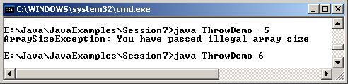
Example
class ArraySizeException extends NegativeArraySizeException
{
ArraySizeException() // constructor
{
super("You have passed illegal array size");
}
}
class UserDefinedException
{
int size, array[];
UserDefinedException(int val)
{
size = val;
try
{
checkSize();
}
catch(ArraySizeException e)
{
System.out.println(e);
}
}
void checkSize() throws ArraySizeException
{
if(size < 0)
throw new ArraySizeException();
array = new int[3];
for(int count = 0; count < 3; count++)
array[count] = count+1;
}
public static void main(String arg[])
{
new UserDefinedException(Integer.parseInt(arg[0]));
}
}
Output

Slide 24
Programming with assertions
Assertions enables the programmer to test assumptions about the program.
Ways of writing assertion statements are:
  assert expression;
  assert expression1:expression2;
The expression in the first form will have a boolean value and evaluate whether the expression is true and if it is false it will throw an AssertionError.
The expression1 in the second form will be a boolean expression and expression2 can have any value, except that it cannot invoke a void method.
If expression1 evaluates to false it will throw an AssertionError. The value in expression2 will be passed to AssertionError constructor and the value will be used to display the error message.

Slide 25
Programming with assertions Contd…
Situations for assertion statements
  Internal invariants: assertion can be used wherever it asserts an invariant
  Control Flow Invariants: an assertion can be placed at any location where control cannot be reached
  Preconditions,post conditions and class invariants
Command for compiling files that uses assertion statements is:
  javac –source 1.4 filename

Slide 26
Summary
Whenever an error is encountered while executing a program, an Exception occurs.
An Exception occurs at run time in a code sequence.
Every exception that is thrown must be caught, or the application terminates abruptly.
Exception handling allows combining error processing in one place.
Java uses the try and catch block to handle exceptions.

Slide 27
Summary Contd…
The statements in the try block throw exceptions and the catch block handles them.
Multiple catch blocks can be used together to process various exception types separately.
The throws keyword is used to list the exception that a method can throw.
The throw keyword is used to indicate that exception has occurred.
The statements in the finally block are executed irrespective of whether an exception occurs or not.

